Slide 1
Laravel with MVC

Slide 2
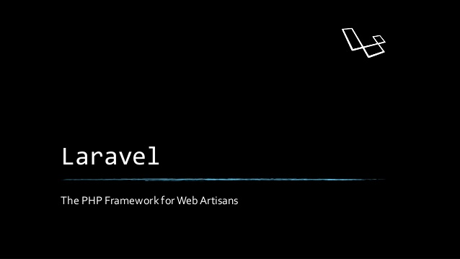

Slide 3
What is laravel
Laravel is a free open-source PHP web framework, created byTaylor Otwell and intended for the development of web application following the model-view-controller (MVC) architectural pattern. ▪ Laravel is a web application framework with expressive, elegant syntax.

Slide 4
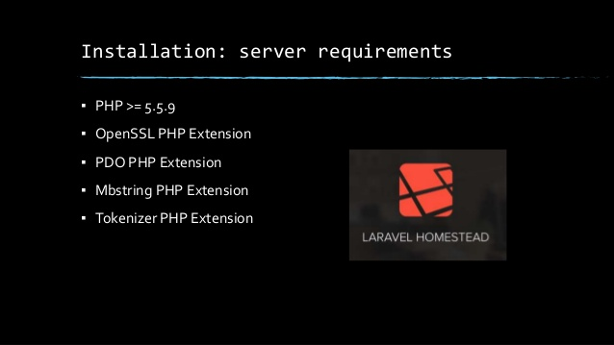

Slide 5
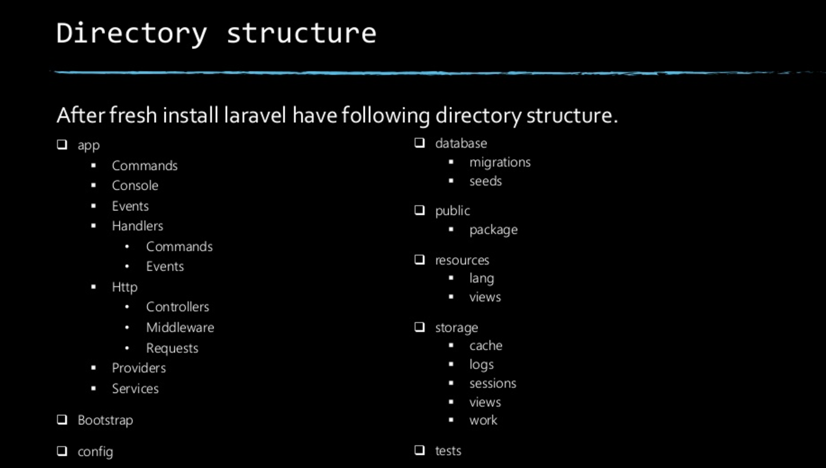

Slide 6
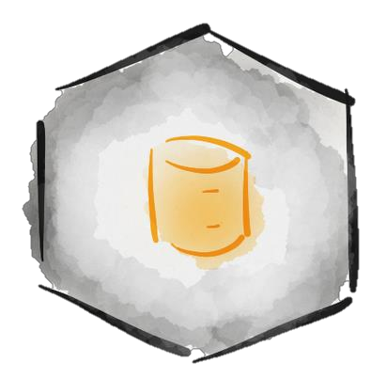
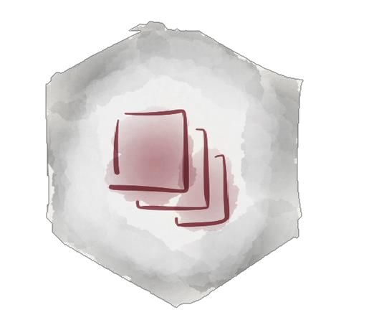
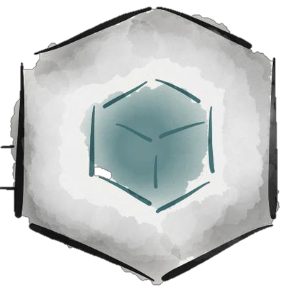
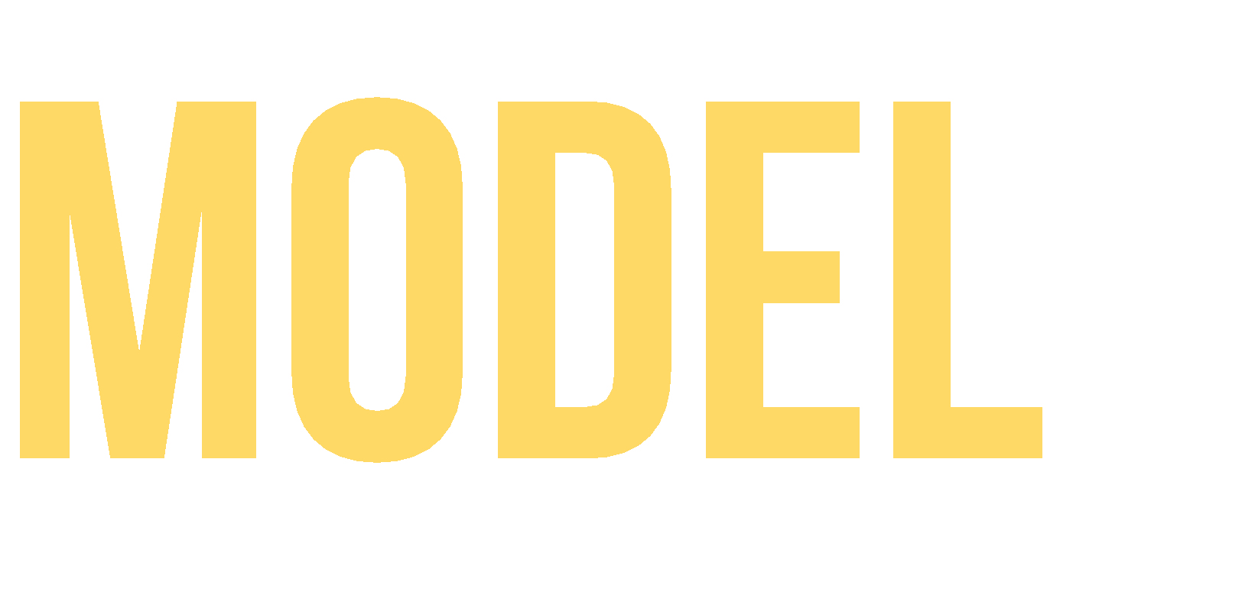



Slide 7
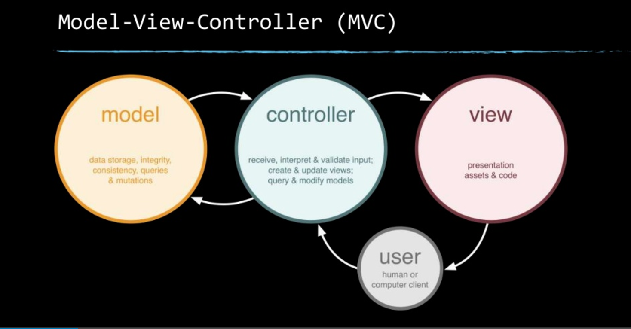

Slide 8

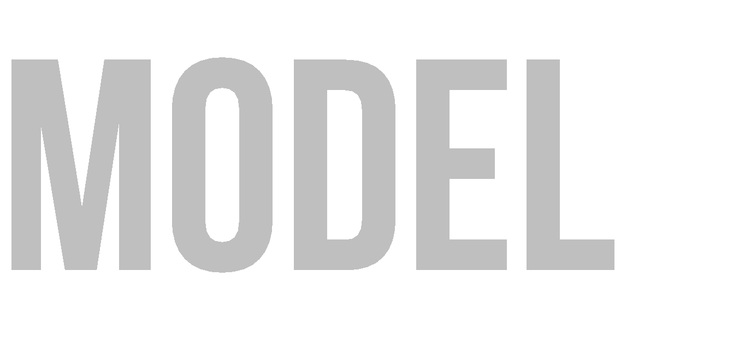



Software architecture pattern that separates the model, the user interface and control logic of an application in three distinct components.

Slide 9

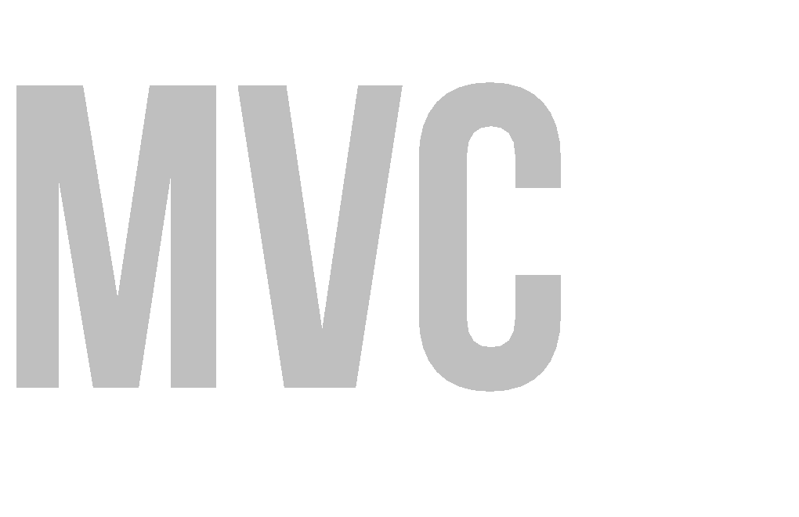

MVC proposes the construction of three distinct components. One side for the representation of information, and on the other hand for user interaction.
One model
Many Views
Many Controllers

Slide 10

The Model
The View
The Controller
Representation of domain data. Business logic
Persistence mechanism
User Interface Interaction elements
Intermediary between Model and View It maps user actions – model actions Select the view and provide information to itself

Slide 11
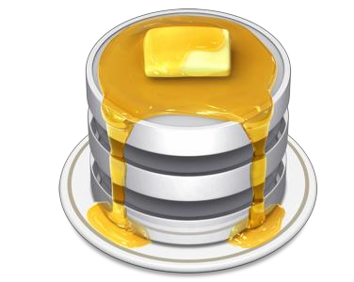
It is the specific representation of the information with which the system operates. Logic ensures the integrity of data and allows to derive it.

Slide 12
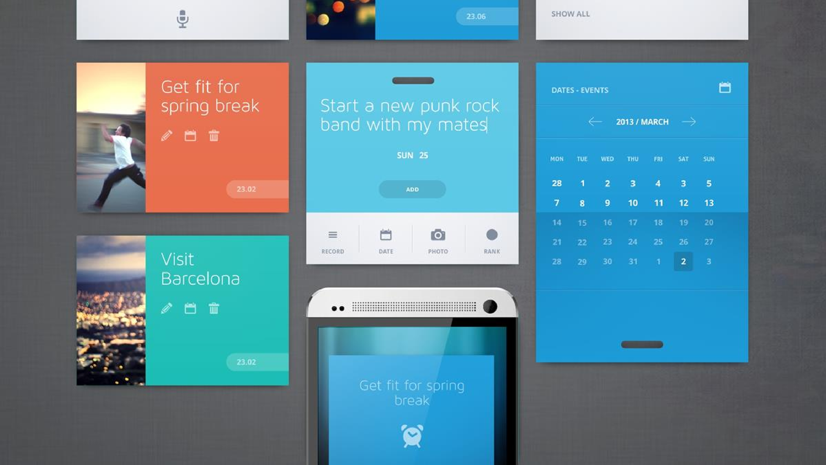
Represents the model in a suitable format to interact and access the data,
usually called "User Interface" (GUI Java, HTML, XML).

Slide 13


It is the link between the view and the model, is responsible for receiving and responding to events, typically user actions and invokes changes on the model and probably in the view.

Slide 14
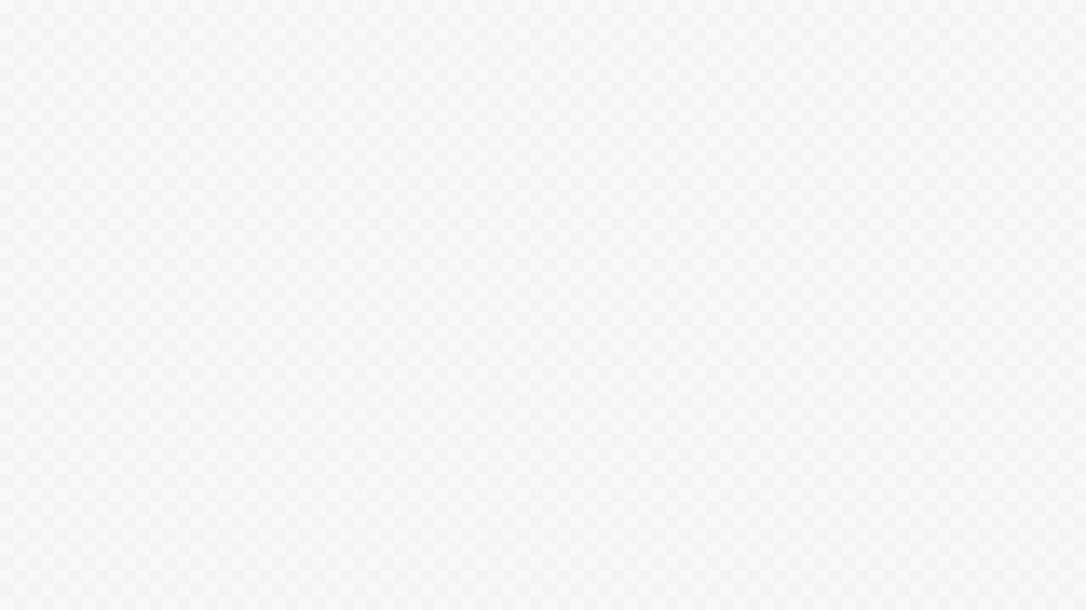

Organization
Rapid Application Development
Reusing Code
Parallel development
It presents the same information in different ways.
The views and application behavior should reflect the manipulations of the data immediately.
It allows different user interface standards or port it to other environments where the application code should not be affected.

Slide 15
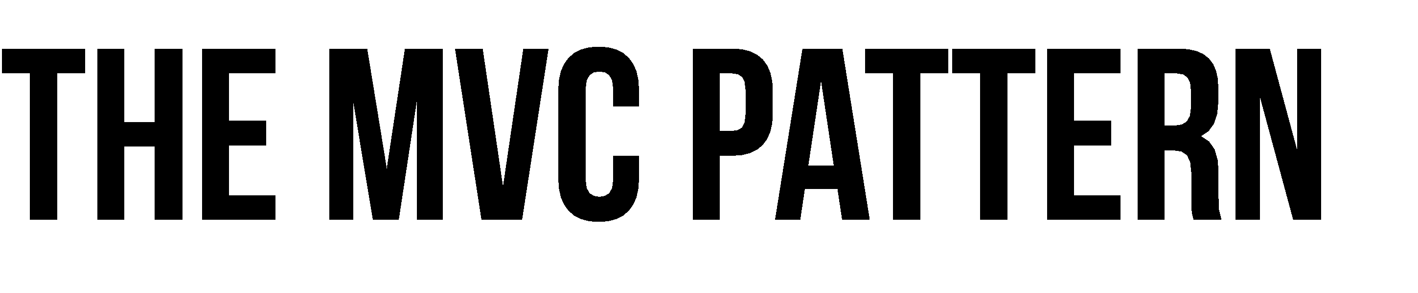
Control Flow
The user performs an action on the interface.
The controller takes the input event.
The controller notifies the user action to the model,
which may involve a change of state of the model.
It generates a new view. The view takes the data model.
The user interface waits for another user interaction,
which starts a new cycle.

Slide 16





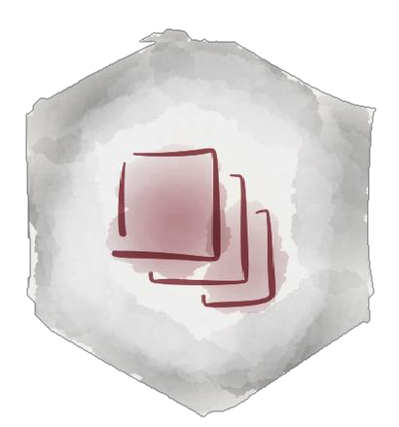



Controller updates the model
View alerts controller of a particular event
View grabs model data and updates itself
Model alerts view that it has changed
User interacts with a
view

Slide 17





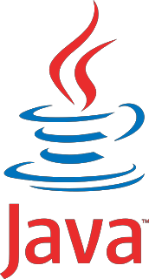
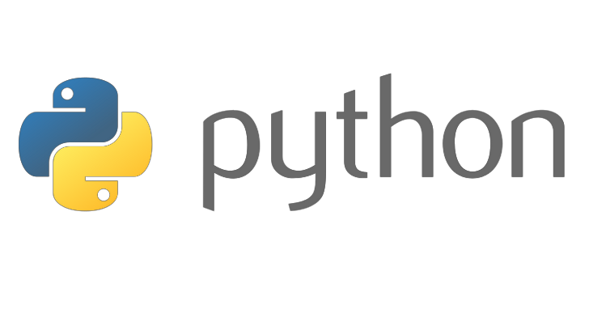
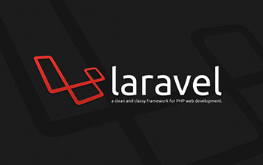
It applies to all types of systems
And technologies (Java, Ruby, Python, Perl, Flex, Laravel, Net, etc..)

